Slide 1
Upper-level Flow, Convergence, Divergence, and Rossby Waves in the NEBs Jet

Slide 2
Bottom Line Up Front
We show that Rossby waves in the upper-level flow lead to convergence (cyclonic) with subsidence in 5-micron hot spots and divergence (anticyclonic) with uplift in ammonia enhanced regions centered to the southeast of hot spots.
By analogy to terrestrial meteorological analysis, we show that cyclonic flows nestle in low pressure troughs and anticyclonic flows associate with high pressure ridges in the NEBs Rossby wave.
The cyclonic and anticyclonic flow locations are located relative to hot spots visually using the flow analysis of Choi et al. (2007).
We posit conservation of ammonia that is converted between solid phase and gas phase repeatedly along the NEBs jet Rossby wave.

Slide 3
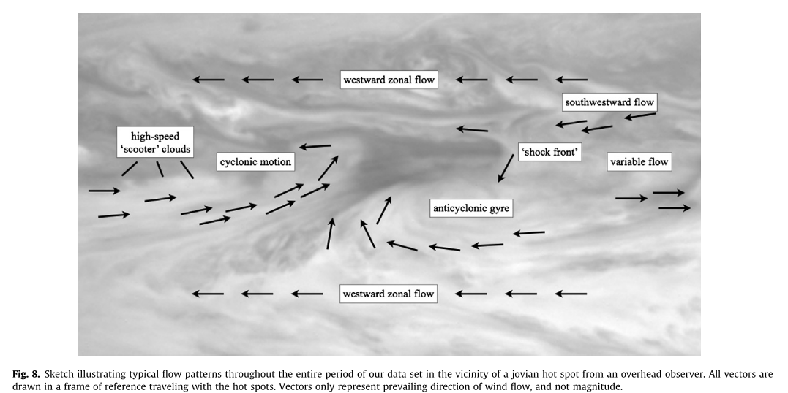
Upper-Level Flow Analysis from Cassini
Convergence (Upper-Level)
Divergence
(Upper-Level)
Choi et al. (2007) analysis (and animations available in supplemental data) supports areas of subsidence/convergence and uplift/divergence

Slide 4
Upper-Level Flow Analysis from Cassini
Divergence
(Upper-Level)
Convergence (Upper-Level)
Choi et al. (2007) analysis (and animations available in supplemental data) supports areas of subsidence/convergence and uplift/divergence

Slide 5
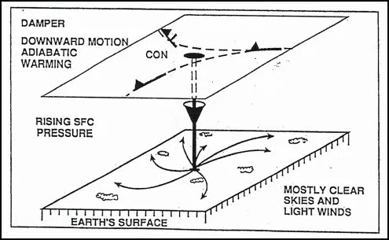
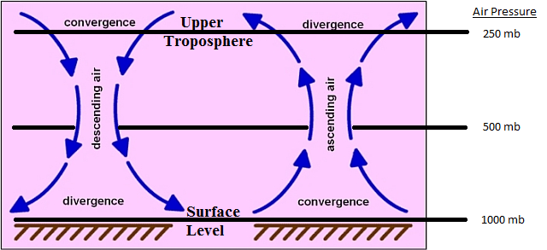
Meteorological Definitions
If convergence is occurring in the upper troposphere the atmosphere will attempt to compensate by initiating divergence in the lower troposphere, this is called the damper effect. This condition results in downward vertical motion and adiabatic warming, which could represent improving weather with increased stability. This is called the Damper Effect.
https://www.weather.gov/source/zhu/ZHU_Training_Page/Miscellaneous/Divergence/divergence.html#:~:text=If%20convergence%20is%20occurring%20in,improving%20weather%20with%20increased%20stability.

Slide 6
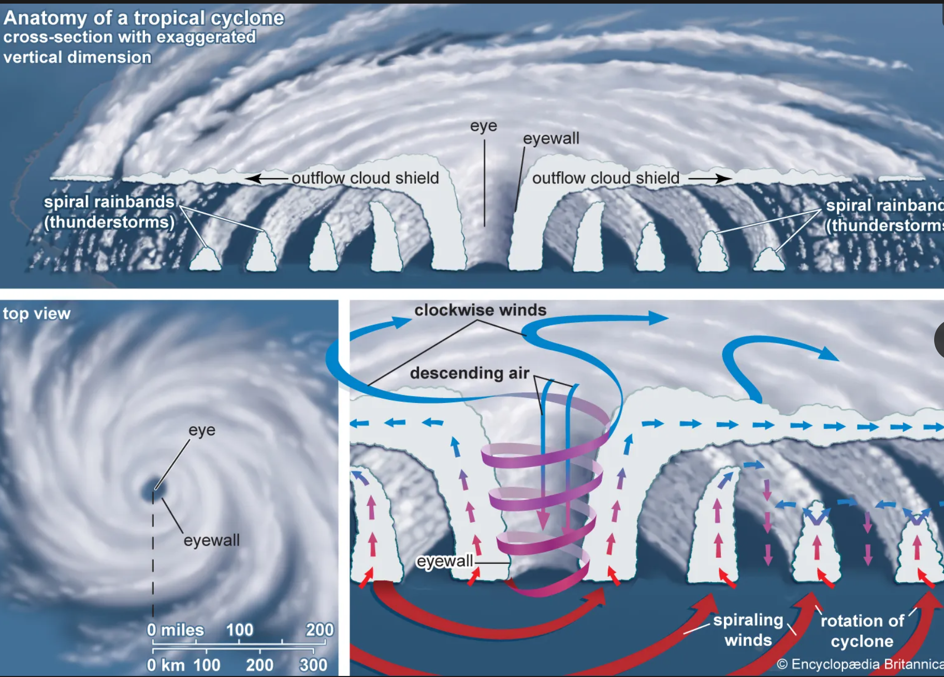
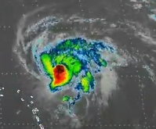
See Lauer Linkedin chat on Hurricanes, Jet Streaks, and Ekman transport
“Cyclonic” storms like hurricanes actually have anti-cyclonic flow at or above the cloud tops.
https://youtu.be/ANb9AQYFA94

Slide 7
A change in color table…
t

Slide 8
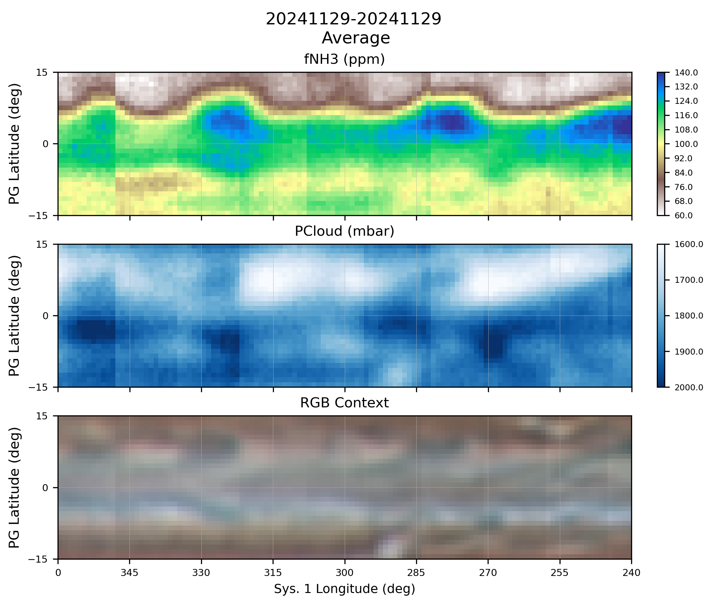
Cyclonic (blue) and anticyclonic (red) were drawn by hand and located on the RGB context image by eye.
Locations were chosen according to the Choi et. al. (2007) flow diagram and supplemental movies.
Then the orange streamlines representing the eastward flow of the NEBs jetstream were drawn by hand and curved appropriately to match the cyclonic and anticyclonic flows.
The relative background flows northward and southward of the NEBs were added as blue and red arrows respectively.
The annotations were then copied to the cloud pressure and ammonia mole fraction plots

Slide 9
Cyclonic (blue) and anticyclonic (red) were drawn by hand and located on the RGB context image by eye.
Locations were chosen according to the Choi et. al. (2007) flow diagram and supplemental movies.
Then the orange streamlines representing the eastward flow of the NEBs jetstream were drawn by hand and curved appropriately to match the cyclonic and anticyclonic flows.
The relative background flows northward and southward of the NEBs were added as blue and red arrows respectively.
The annotations were then copied to the cloud pressure and ammonia mole fraction plots

Slide 10
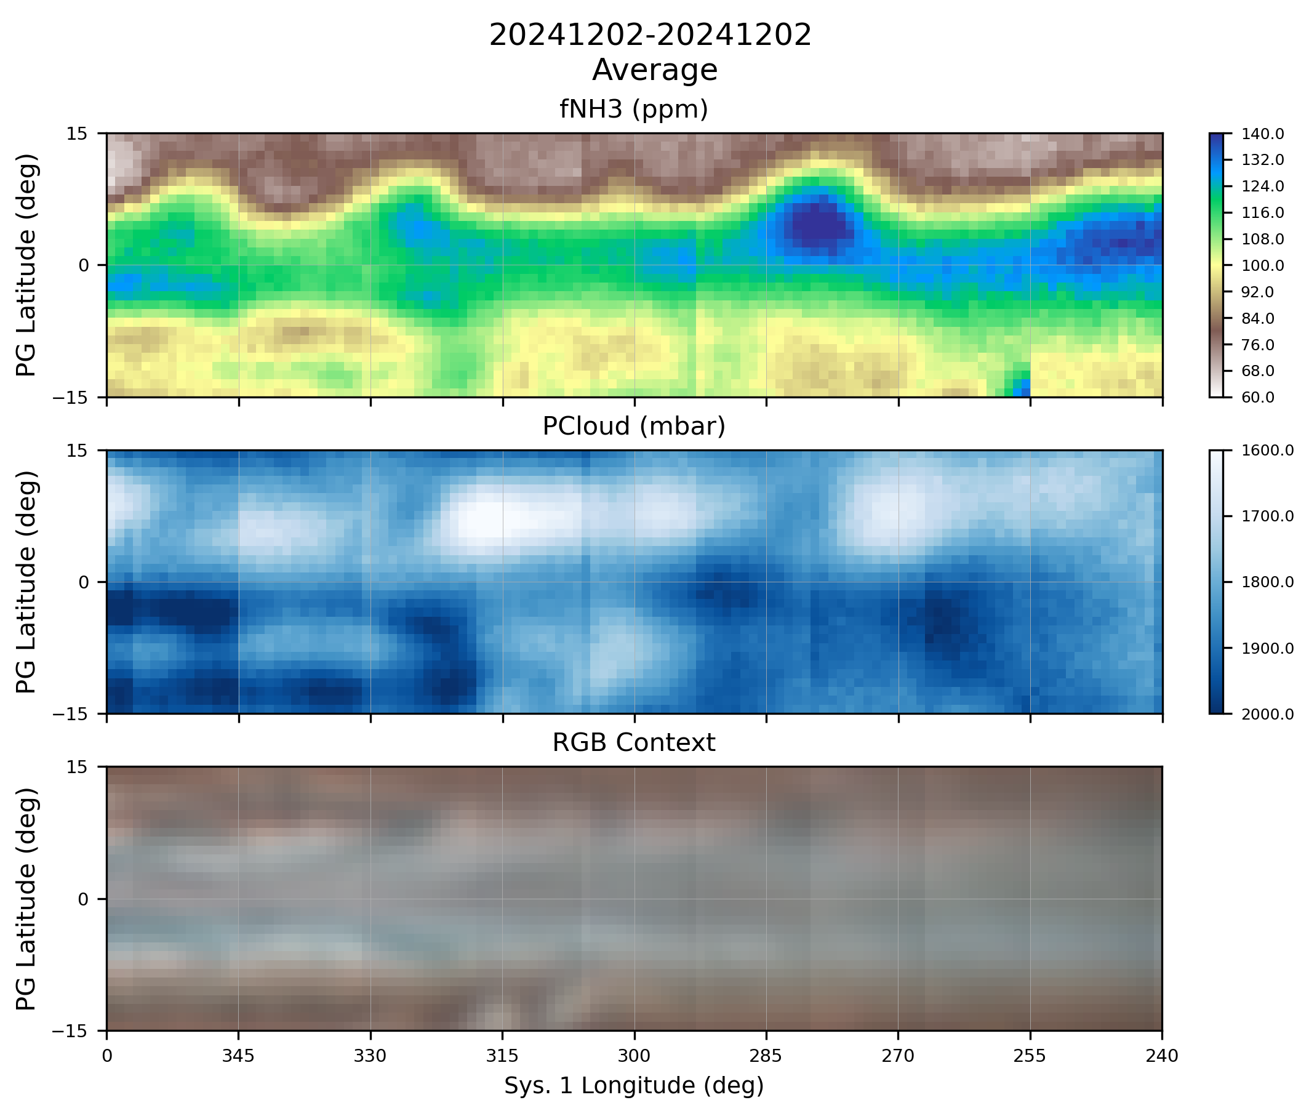
Upper-level cyclonic flow in troughs results in descending, warming, clear air -> Hot Spots
Upper-level anticyclonic flow leads to lower-level convergent flow, uplift, cooling, condensation -> clouds
Clouds then flow east until next upper-level convergent, subsiding flow in a hot spot
Highest humidity straddles upper-level convergence where the cloud aerosols descend, warm, and evaporate back to gaseous ammonia
Thus, we conserve the actual amount of ammonia, it just converts between solid and gas with the wave troughs and ridges.

Slide 11
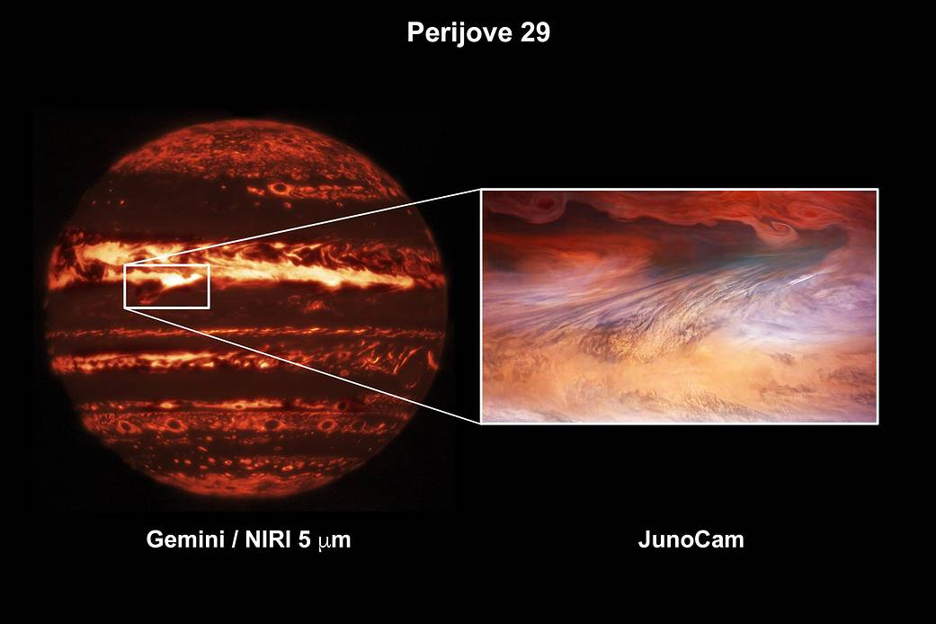
t

Slide 12
See Lauer Linkedin chat on Hurricanes, Jet Streaks, and Ekman transport
“Cyclonic” storms like hurricanes actually have anti-cyclonic flow at or above the cloud tops.
https://youtu.be/ANb9AQYFA94

Slide 13
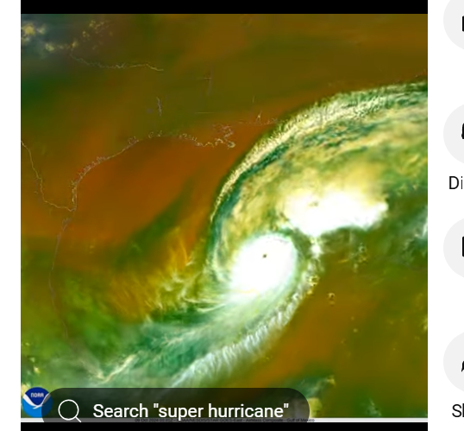
Looks just like mid-SEB outbreak!
https://www.youtube.com/shorts/MWg04jsNWcA

Slide 14
Extra Slides

Slide 15
See Lauer Linkedin chat on Hurricanes, Jet Streaks, and Ekman transport
“Cyclonic” storms like hurricanes actually have anti-cyclonic flow at or above the cloud tops.
https://youtu.be/ANb9AQYFA94

Slide 16
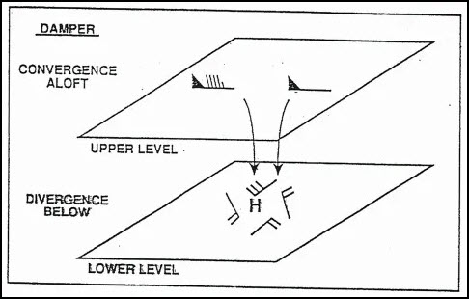
Damper Effect
https://www.weather.gov/source/zhu/ZHU_Training_Page/Miscellaneous/Divergence/divergence.html#:~:text=Convergence%20in%20the%20upper%20troposphere,near%20surface%20high%20pressure%20areas.
https://www.weather.gov/source/zhu/ZHU_Training_Page/Miscellaneous/Divergence/divergence.html#:~:text=Convergence%20in%20the%20upper%20troposphere,near%20surface%20high%20pressure%20areas.

Slide 17
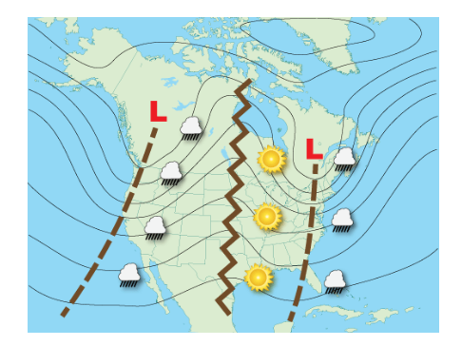
Ridges and Troughs
t
https://www.noaa.gov/jetstream/upper-air-charts/basic-wave-patterns#:~:text=Low%2Dpressure%20troughs%20are%20identified,ridge%20and%20the%20downwind%20trough.

Slide 18
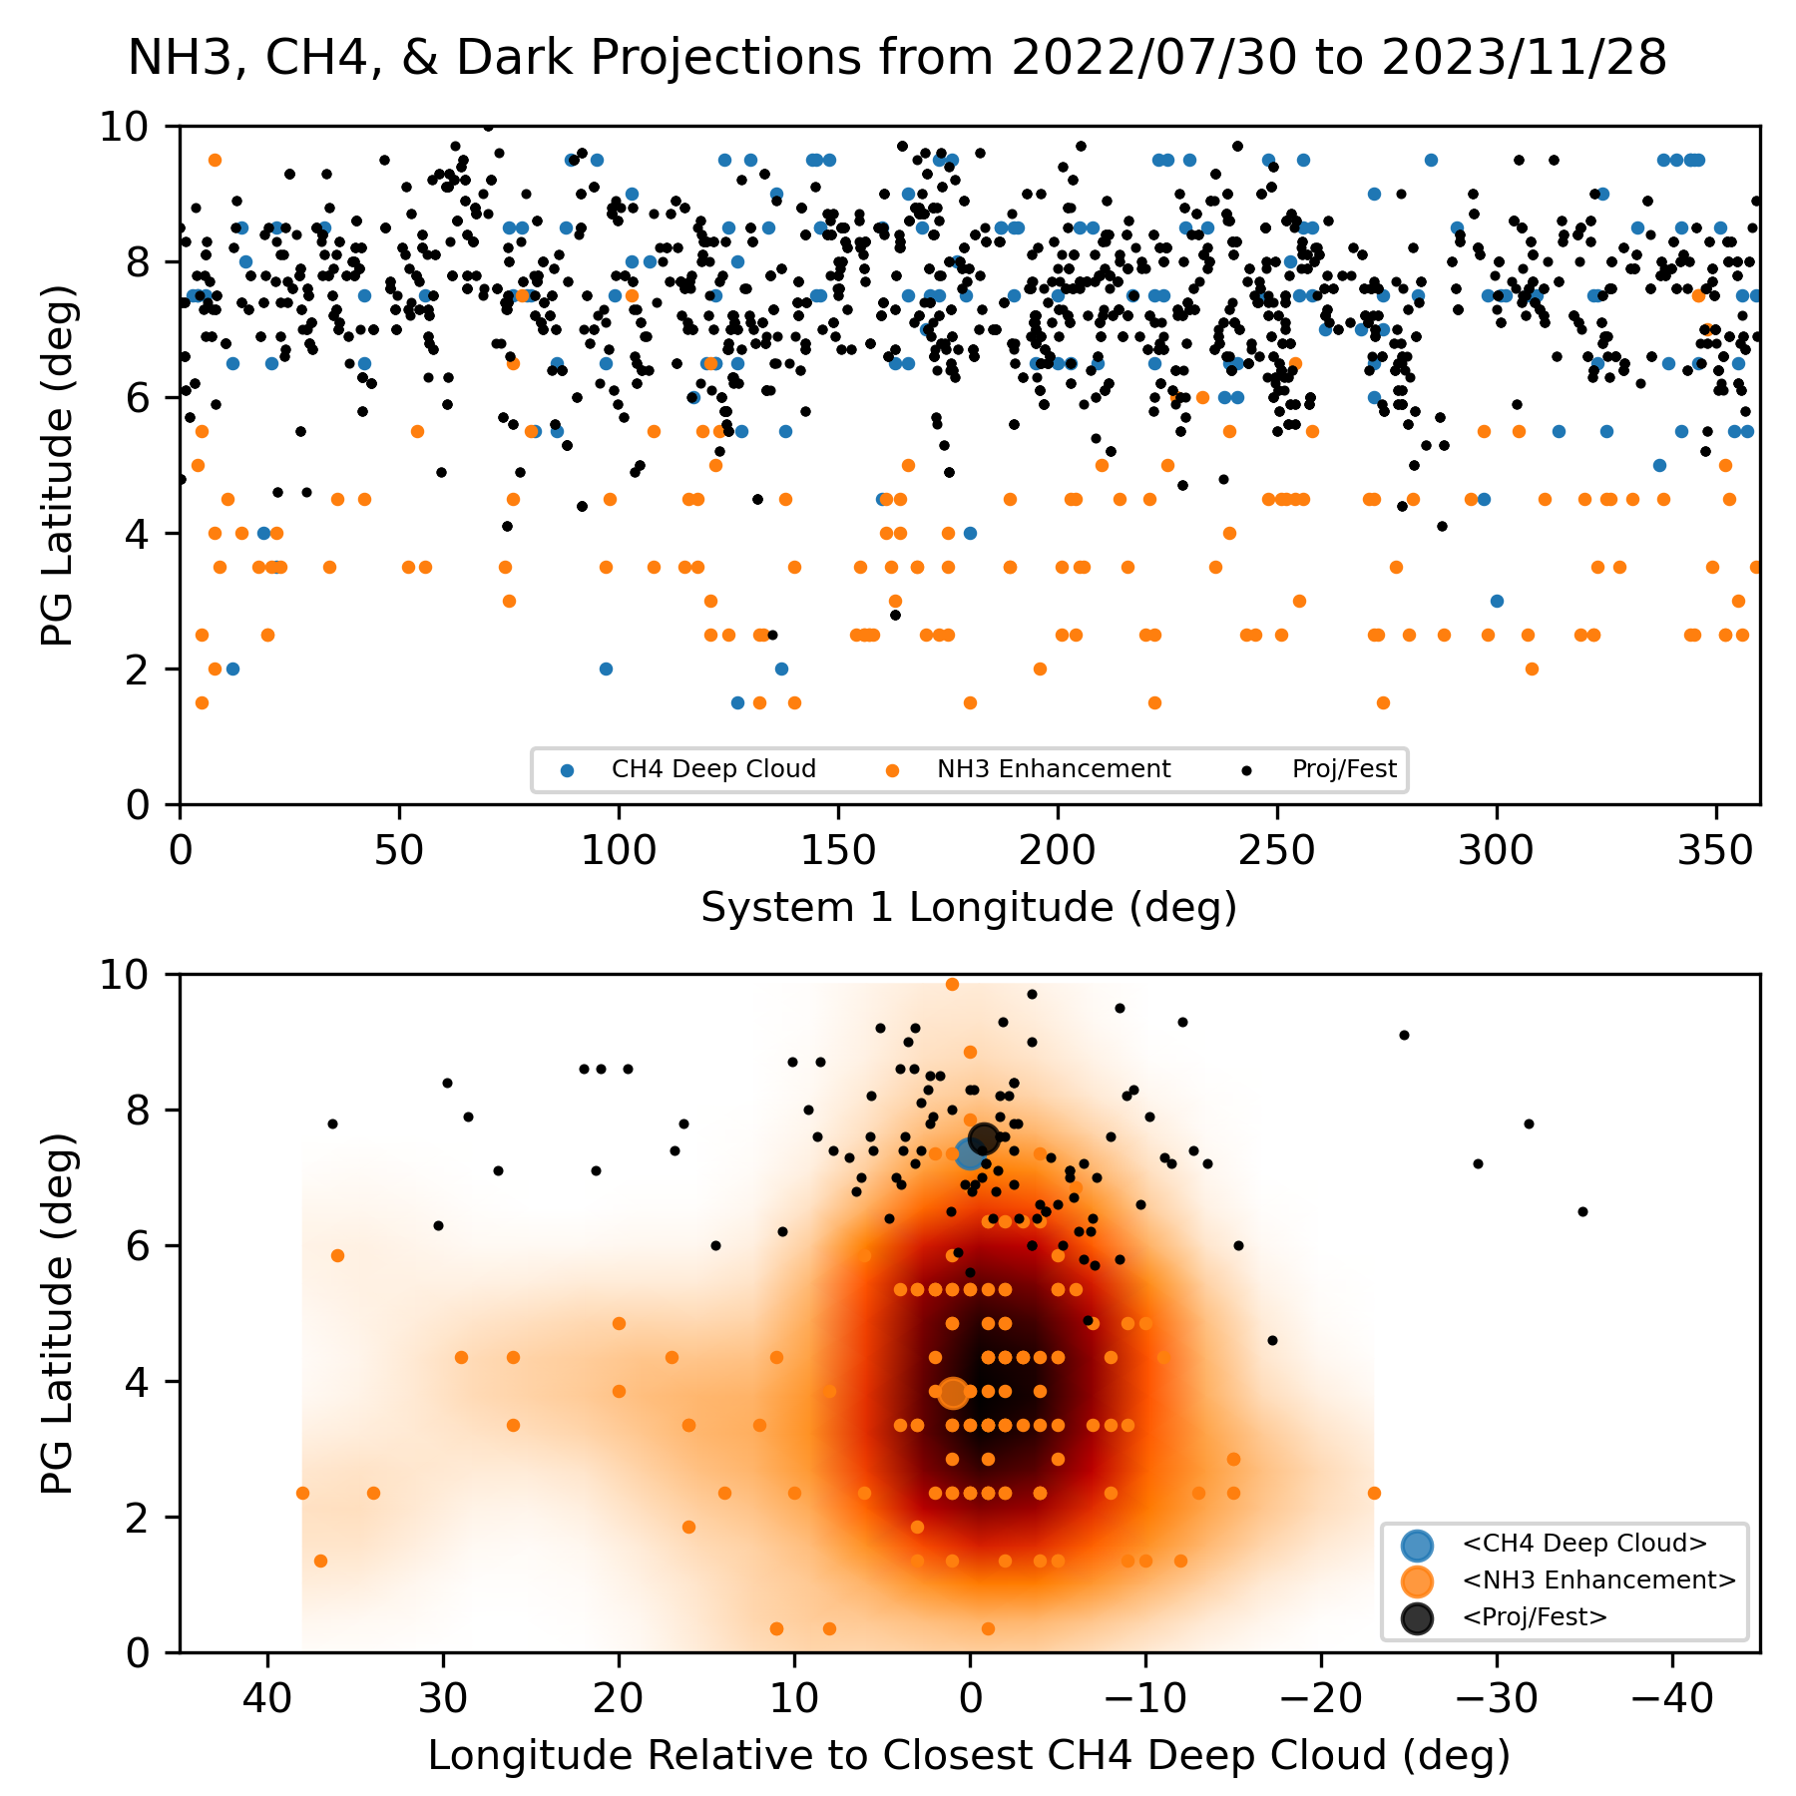
Relative Locations of Deep Clouds, Dark Features, and NH₃ Enhancements
a) NH₃ enhancements, CH₄ deep clouds, and projections/festoons from same UT day are plotted.
b) Same as a), but plotted with longitude relative to closest CH₄ deep cloud and density map of NH₃ relative locations overlaid.
c) Typical flow patterns near around a hot spot (Choi et al., 2013, Fig. 8).
Suggests NH₃ enhancement generally occurs near the anticyclonic gyre and/or westward zonal flow.
a)
c)
b)

Slide 19
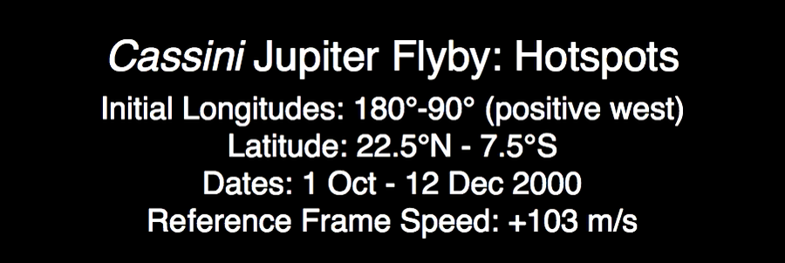
Upper-Level Flows Animated
Upper-Level
Convergence
Upper-Level
Divergence

Slide 20
NEZ ‘Population’ study of NH₃, CH₄ (619 nm), & WINJupos dark projections & festoons
Hypotheses: Plumes and dark formations (5-micron hot spots) represent a source-sink pair for gaseous NH₃.
NH₃ enhancements and CH₄ ‘deep clouds’ from current analysis analyzed :
NH₃ enhancements appear distributed around a centroid ~3.5 deg S of dark formations, generally the same longitude. Some are slightly east of NEDFs
Deep cloud locations match closely with WinJUPOS dark projections & festoons.
Analysis of flow around ‘hot spots’ (Choi et al., 2013):
Rossby wave drives trough/ridge structure
Upper-level convergence

Slide 21
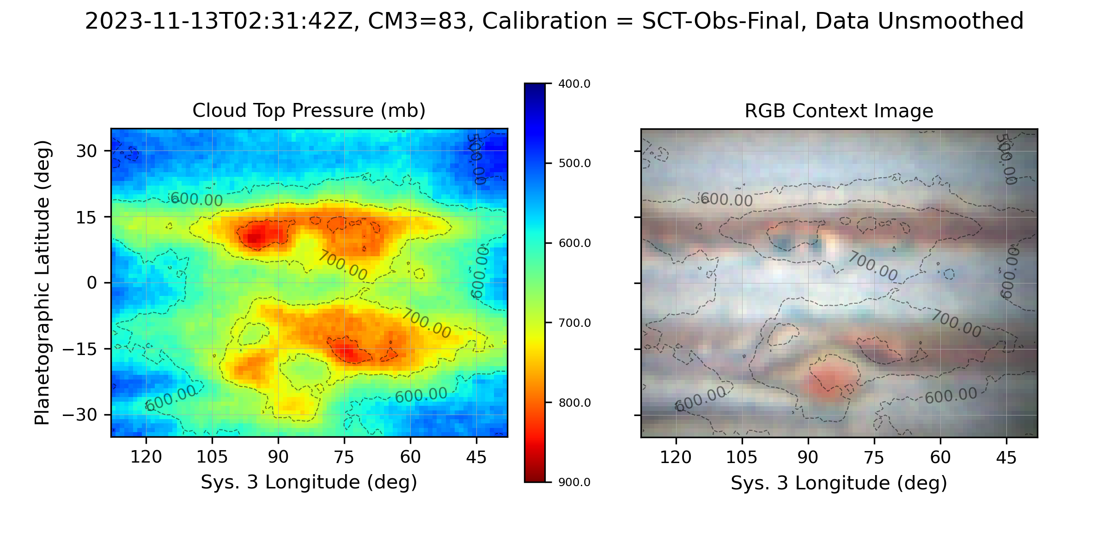
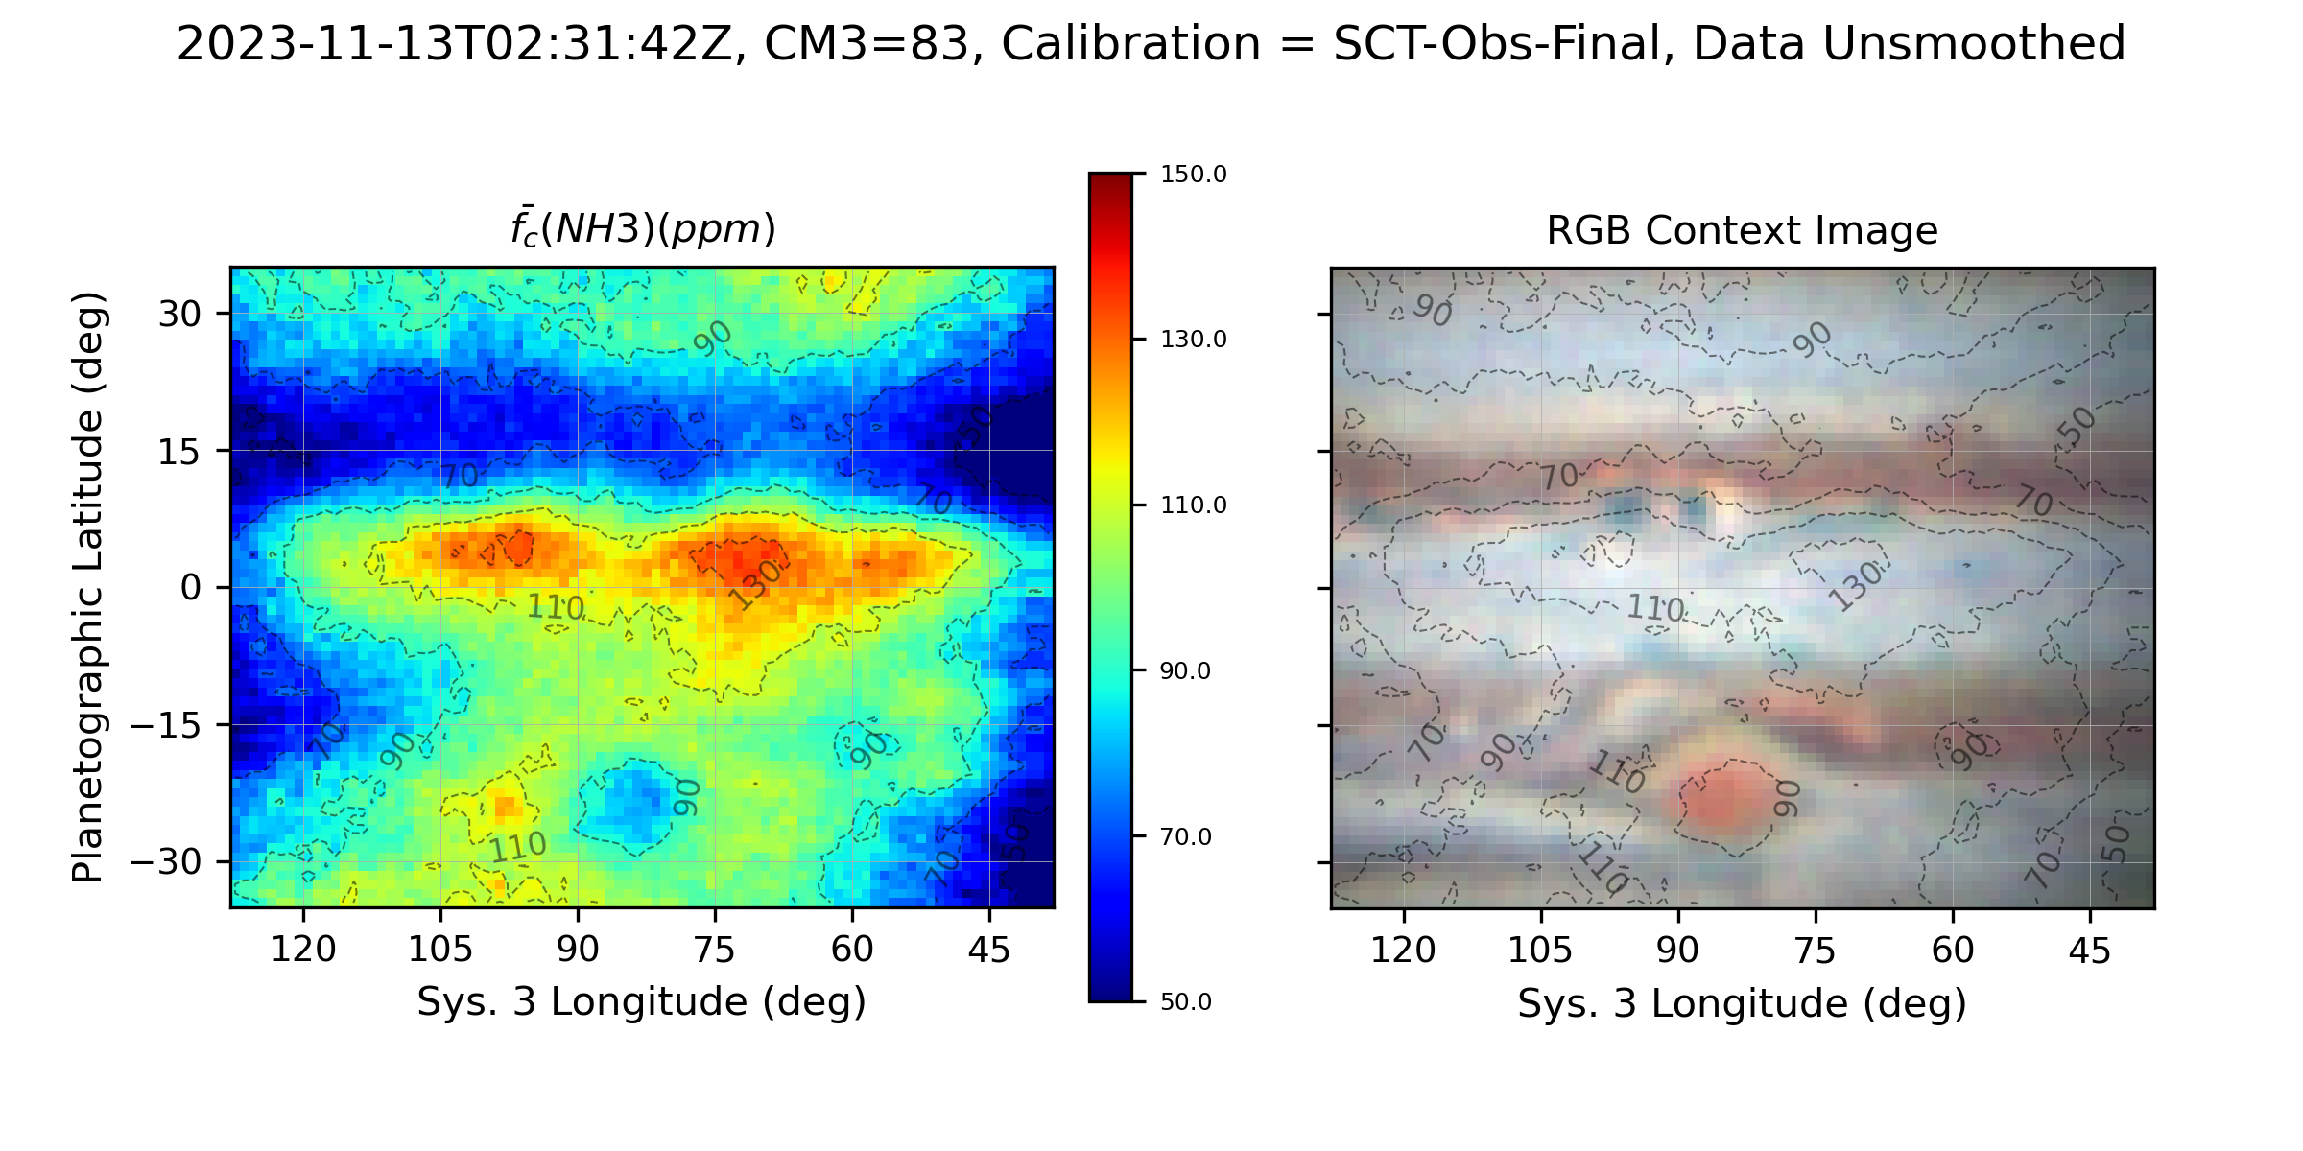
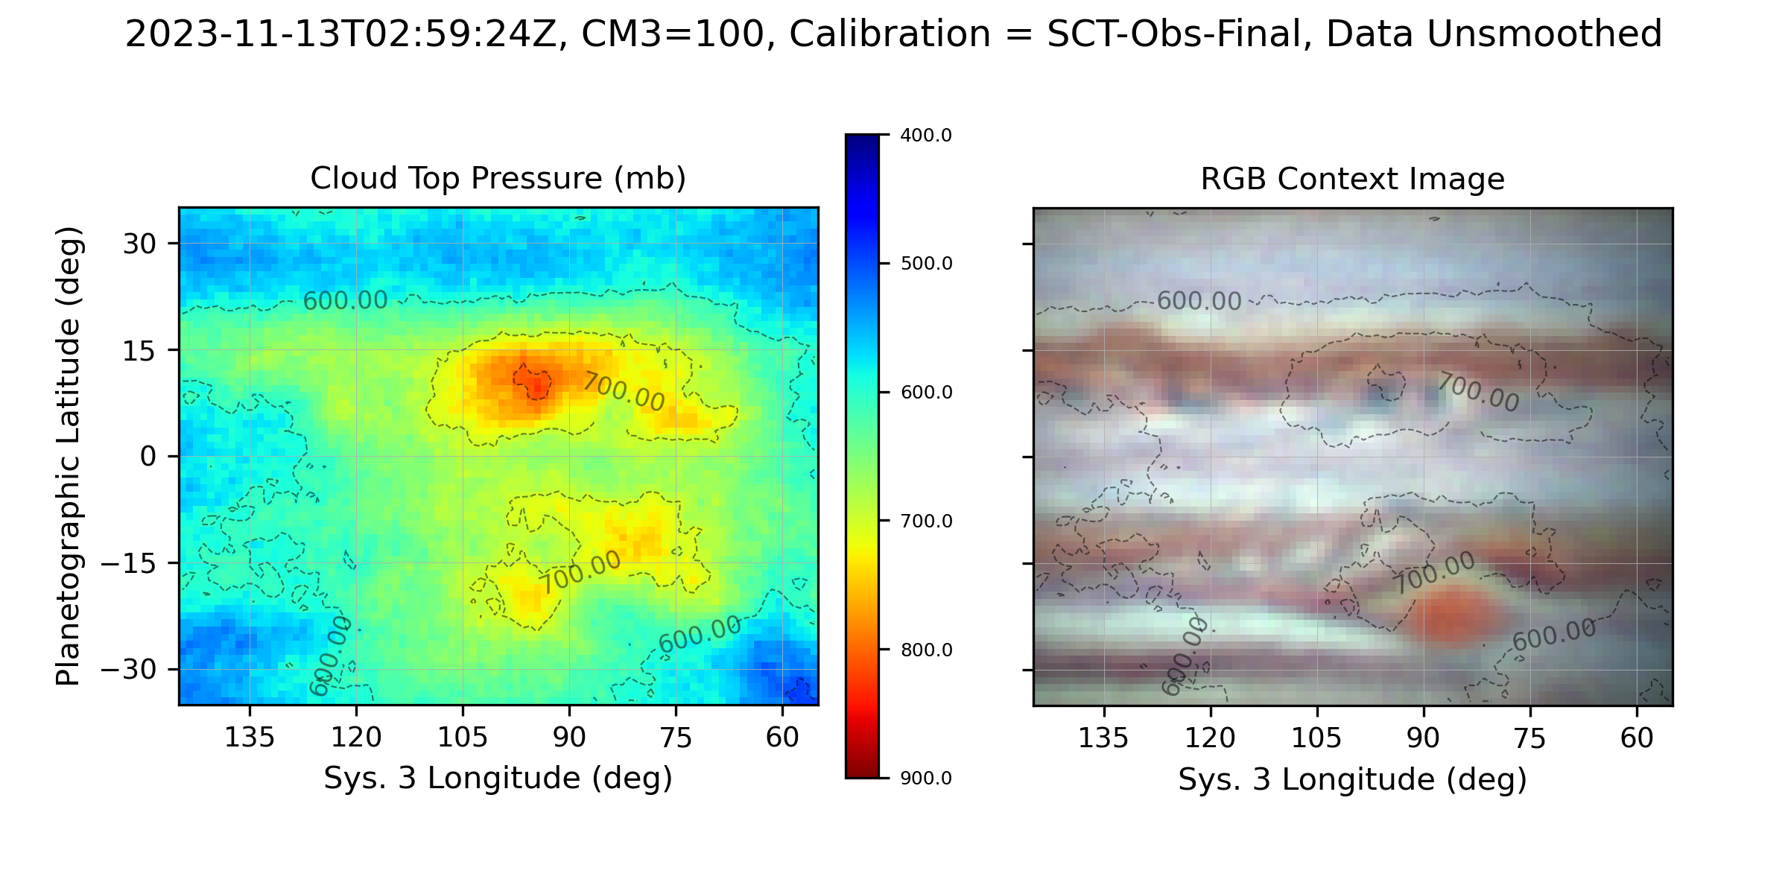
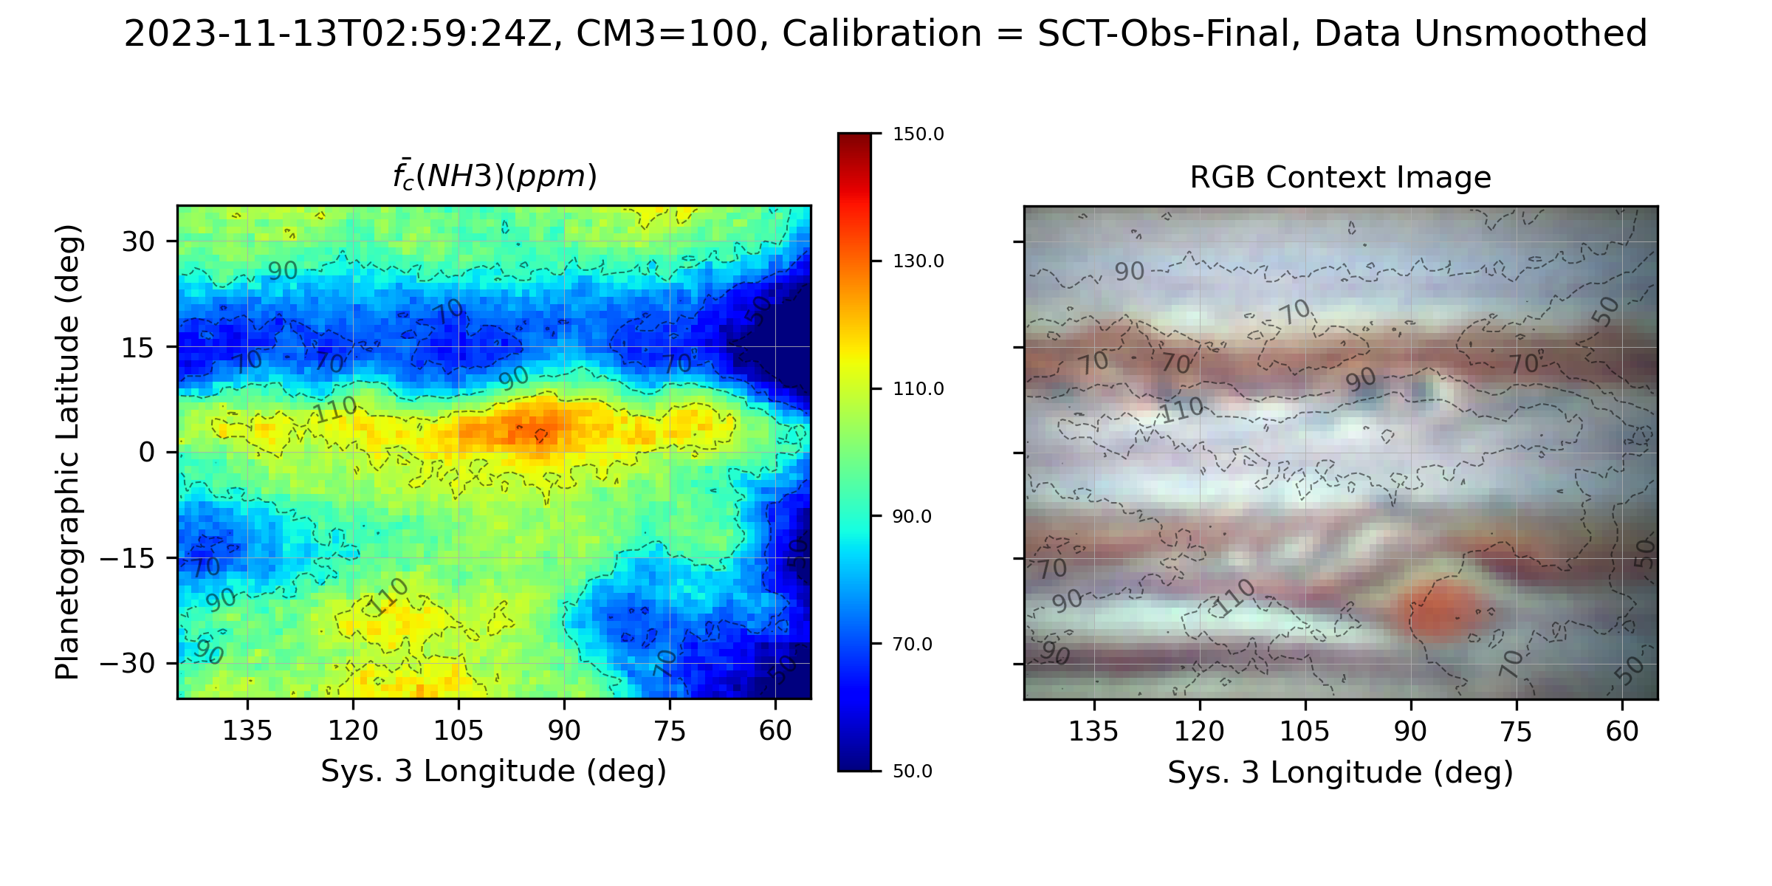
Effective Cloud Top Pressure (620 nm)
Ammonia Mole Fraction, f(NH3) (ppm)

Slide 22
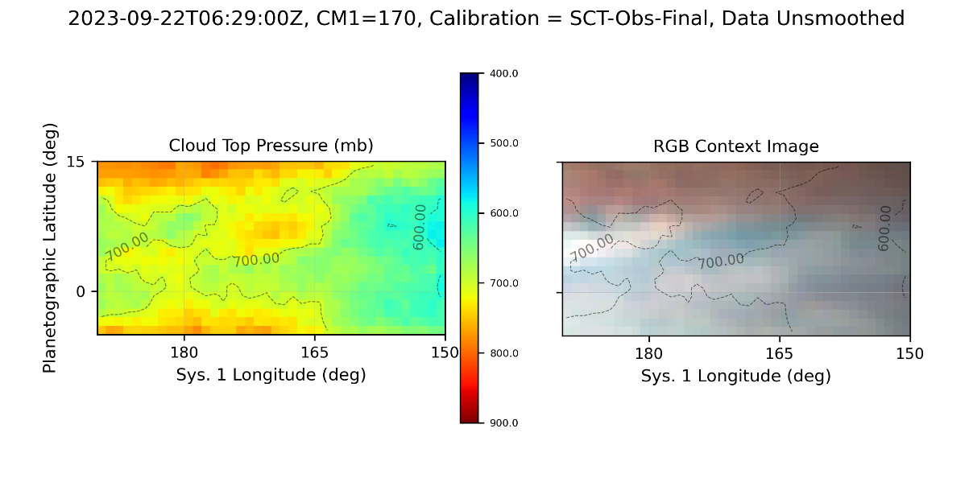
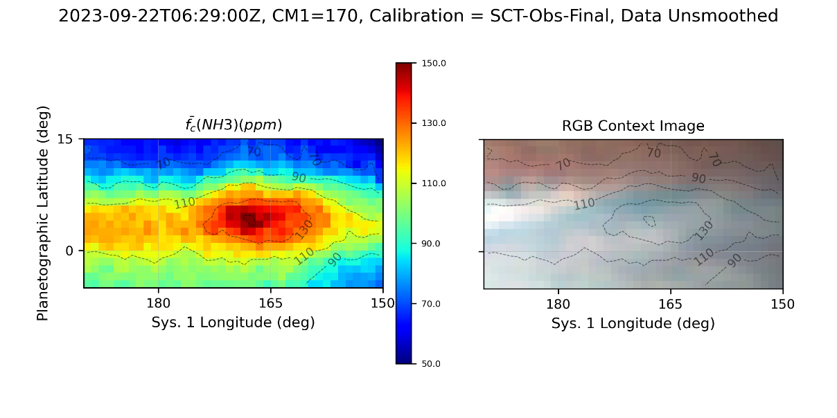
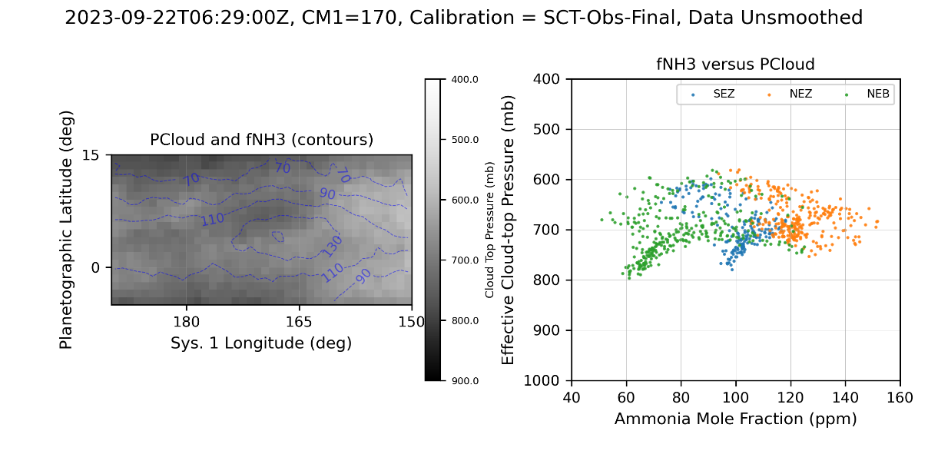
NH₃ enhancements and CH₄ Deep Clouds
a)
Effective cloud top pressure determined by CH₄ absorption. Contours show cloud top pressure overlaid on a contemporaneous optical context image.
Ammonia column-averaged abundance derived from the ratio of ammonia to methane absorption images. Contours show cloud top pressure overlaid on a contemporaneous optical context image.
Left: Effective cloud-top pressure rendered as grey scale with ammonia abundance contours. Right: Scatter plot of effective cloud-top pressure versus ammonia mole fraction by latitude band.
b)
Sixty-six NH₃ and CH₄ observations through 2023-11-28
2022: 18 with SCT, 2 with VLT
2023 45 with SCT
145 CH4 cloud holes / deep clouds
146 NH3 enhanced regions
Dark Projections & Festoons from WinJUPOS
Total 7082 positions between 2022-06-01 and 2023-11-22
c)

Slide 23
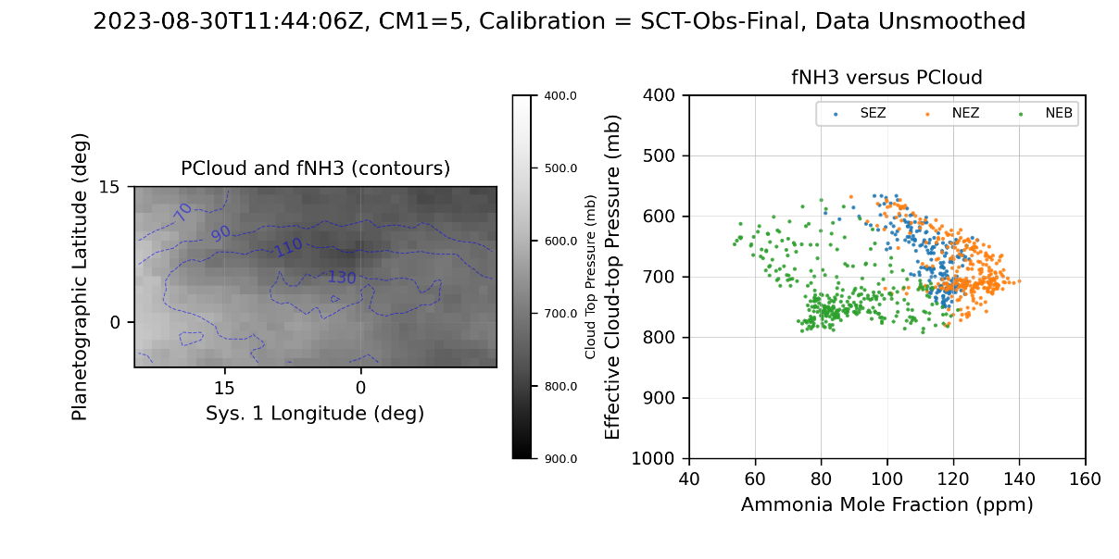
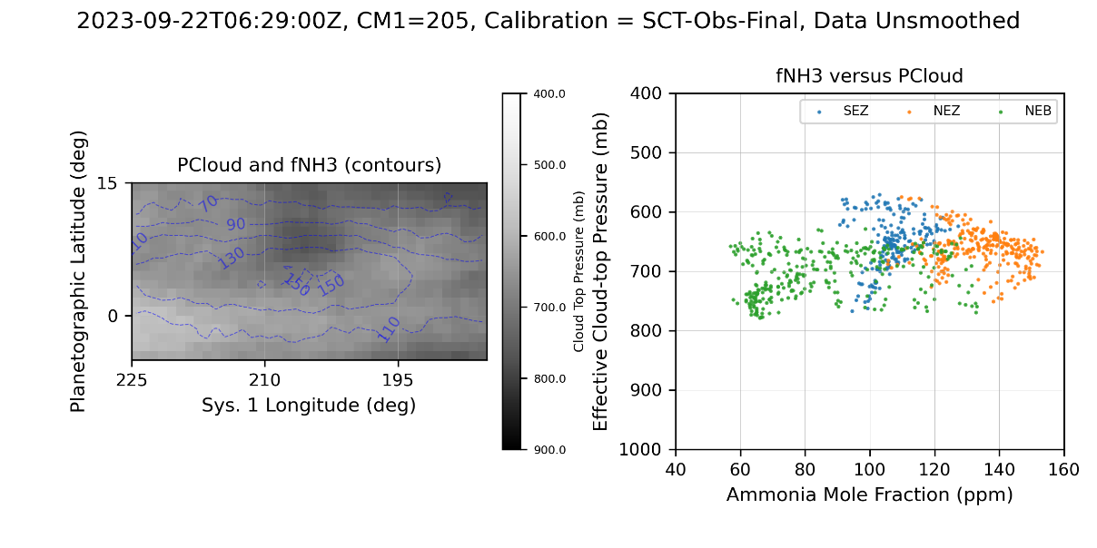
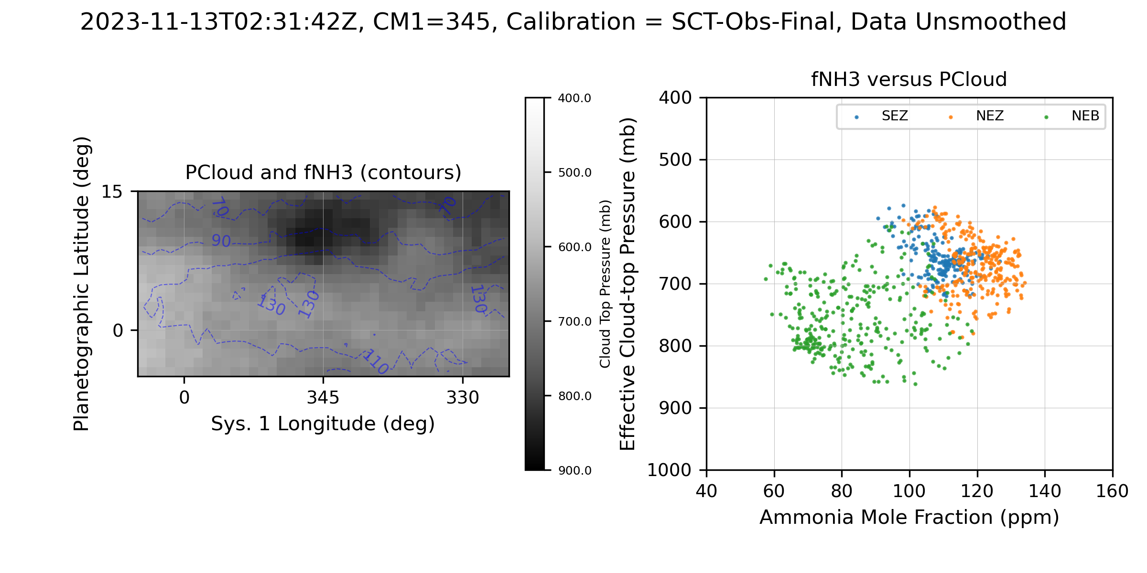
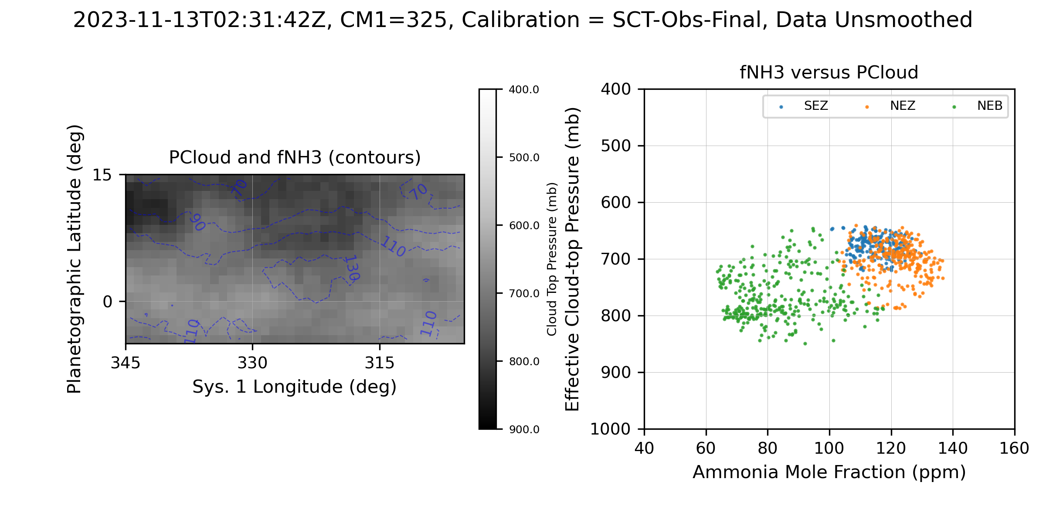
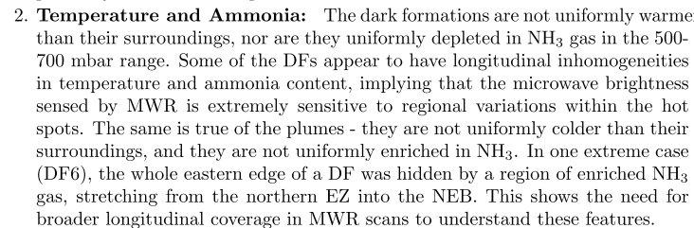
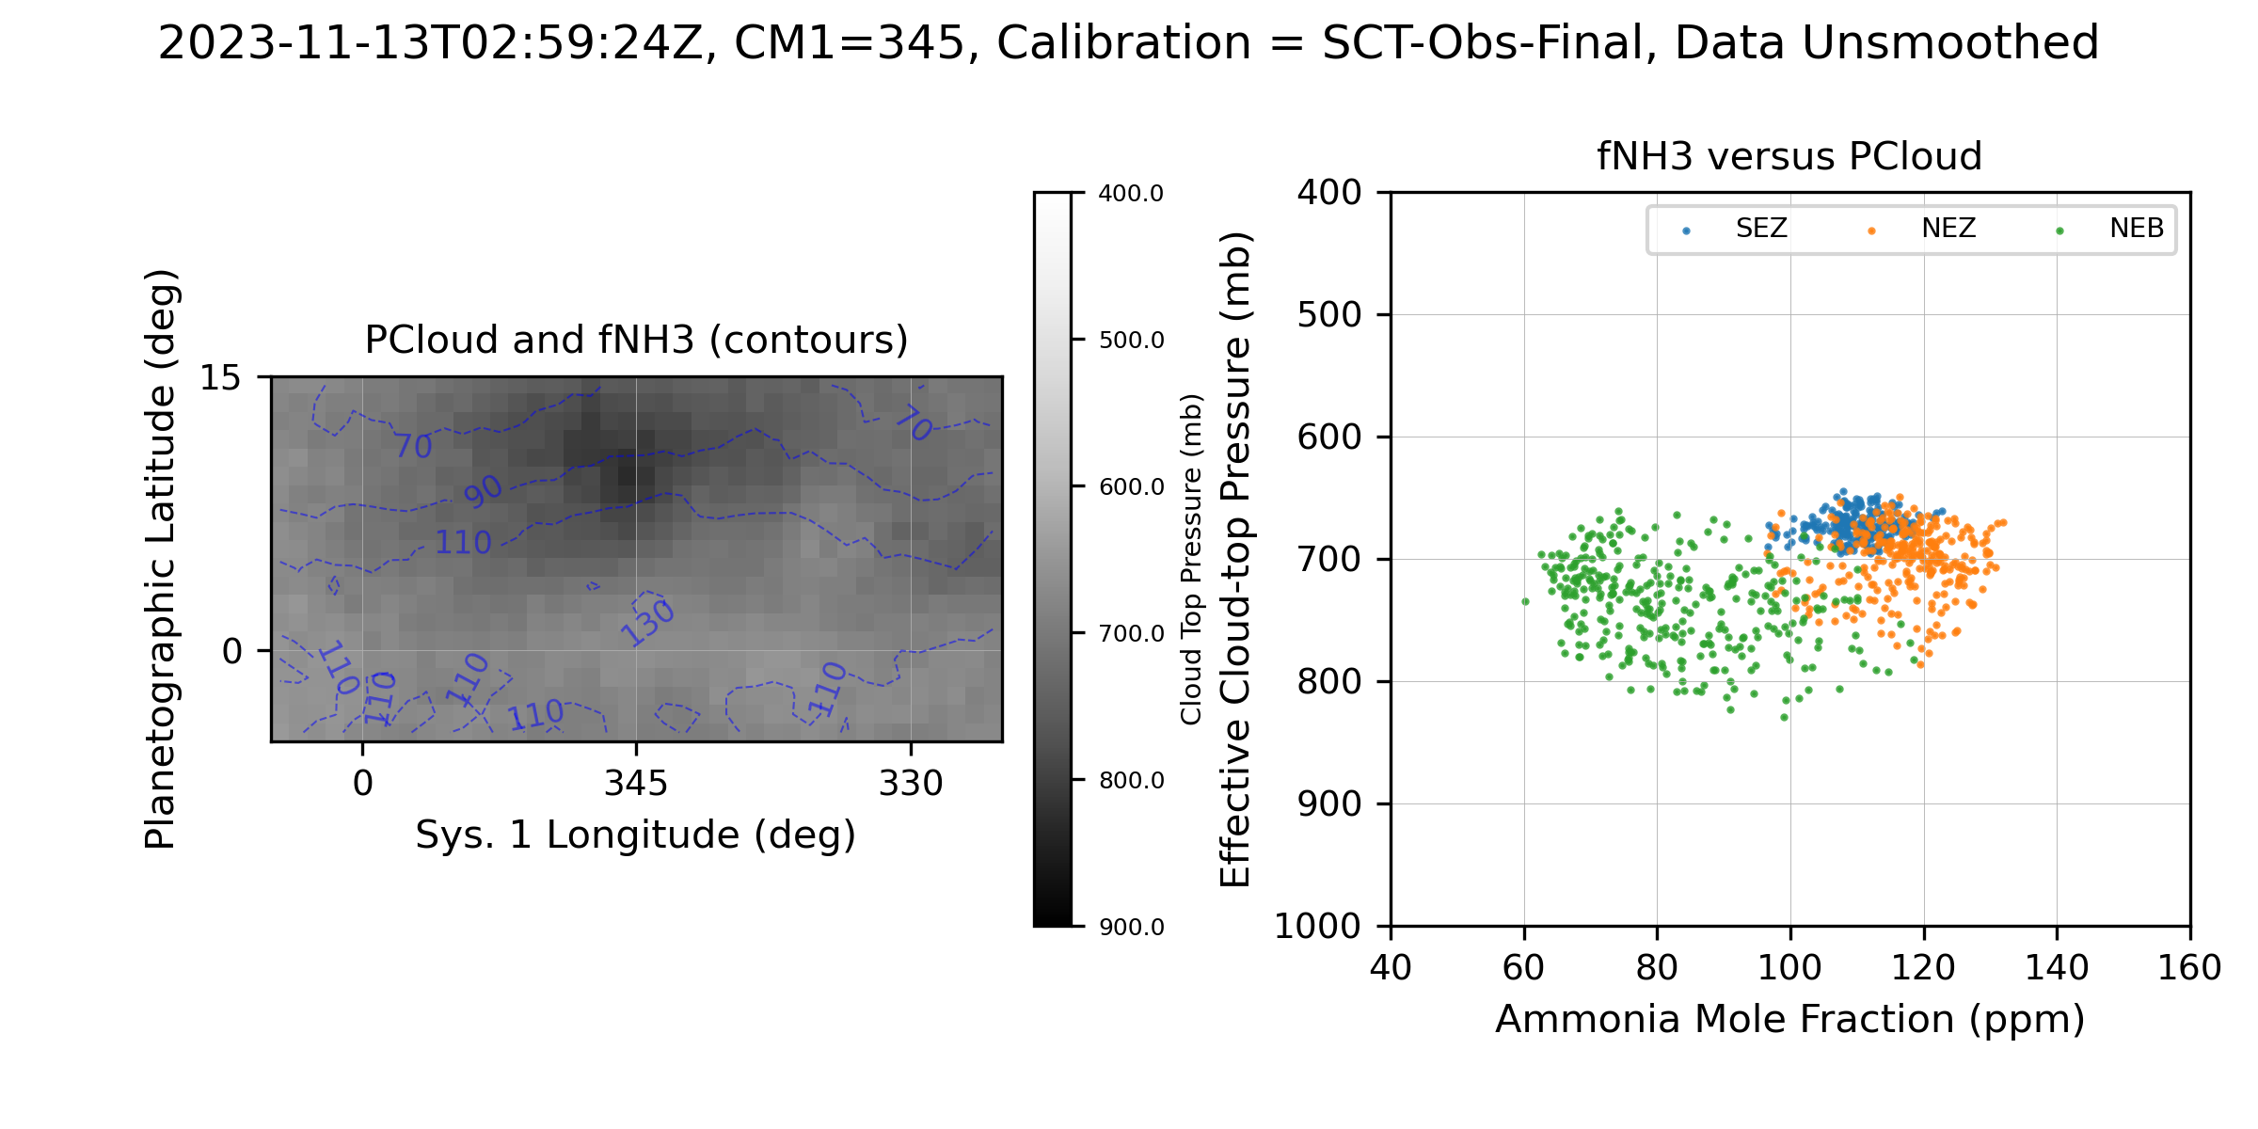
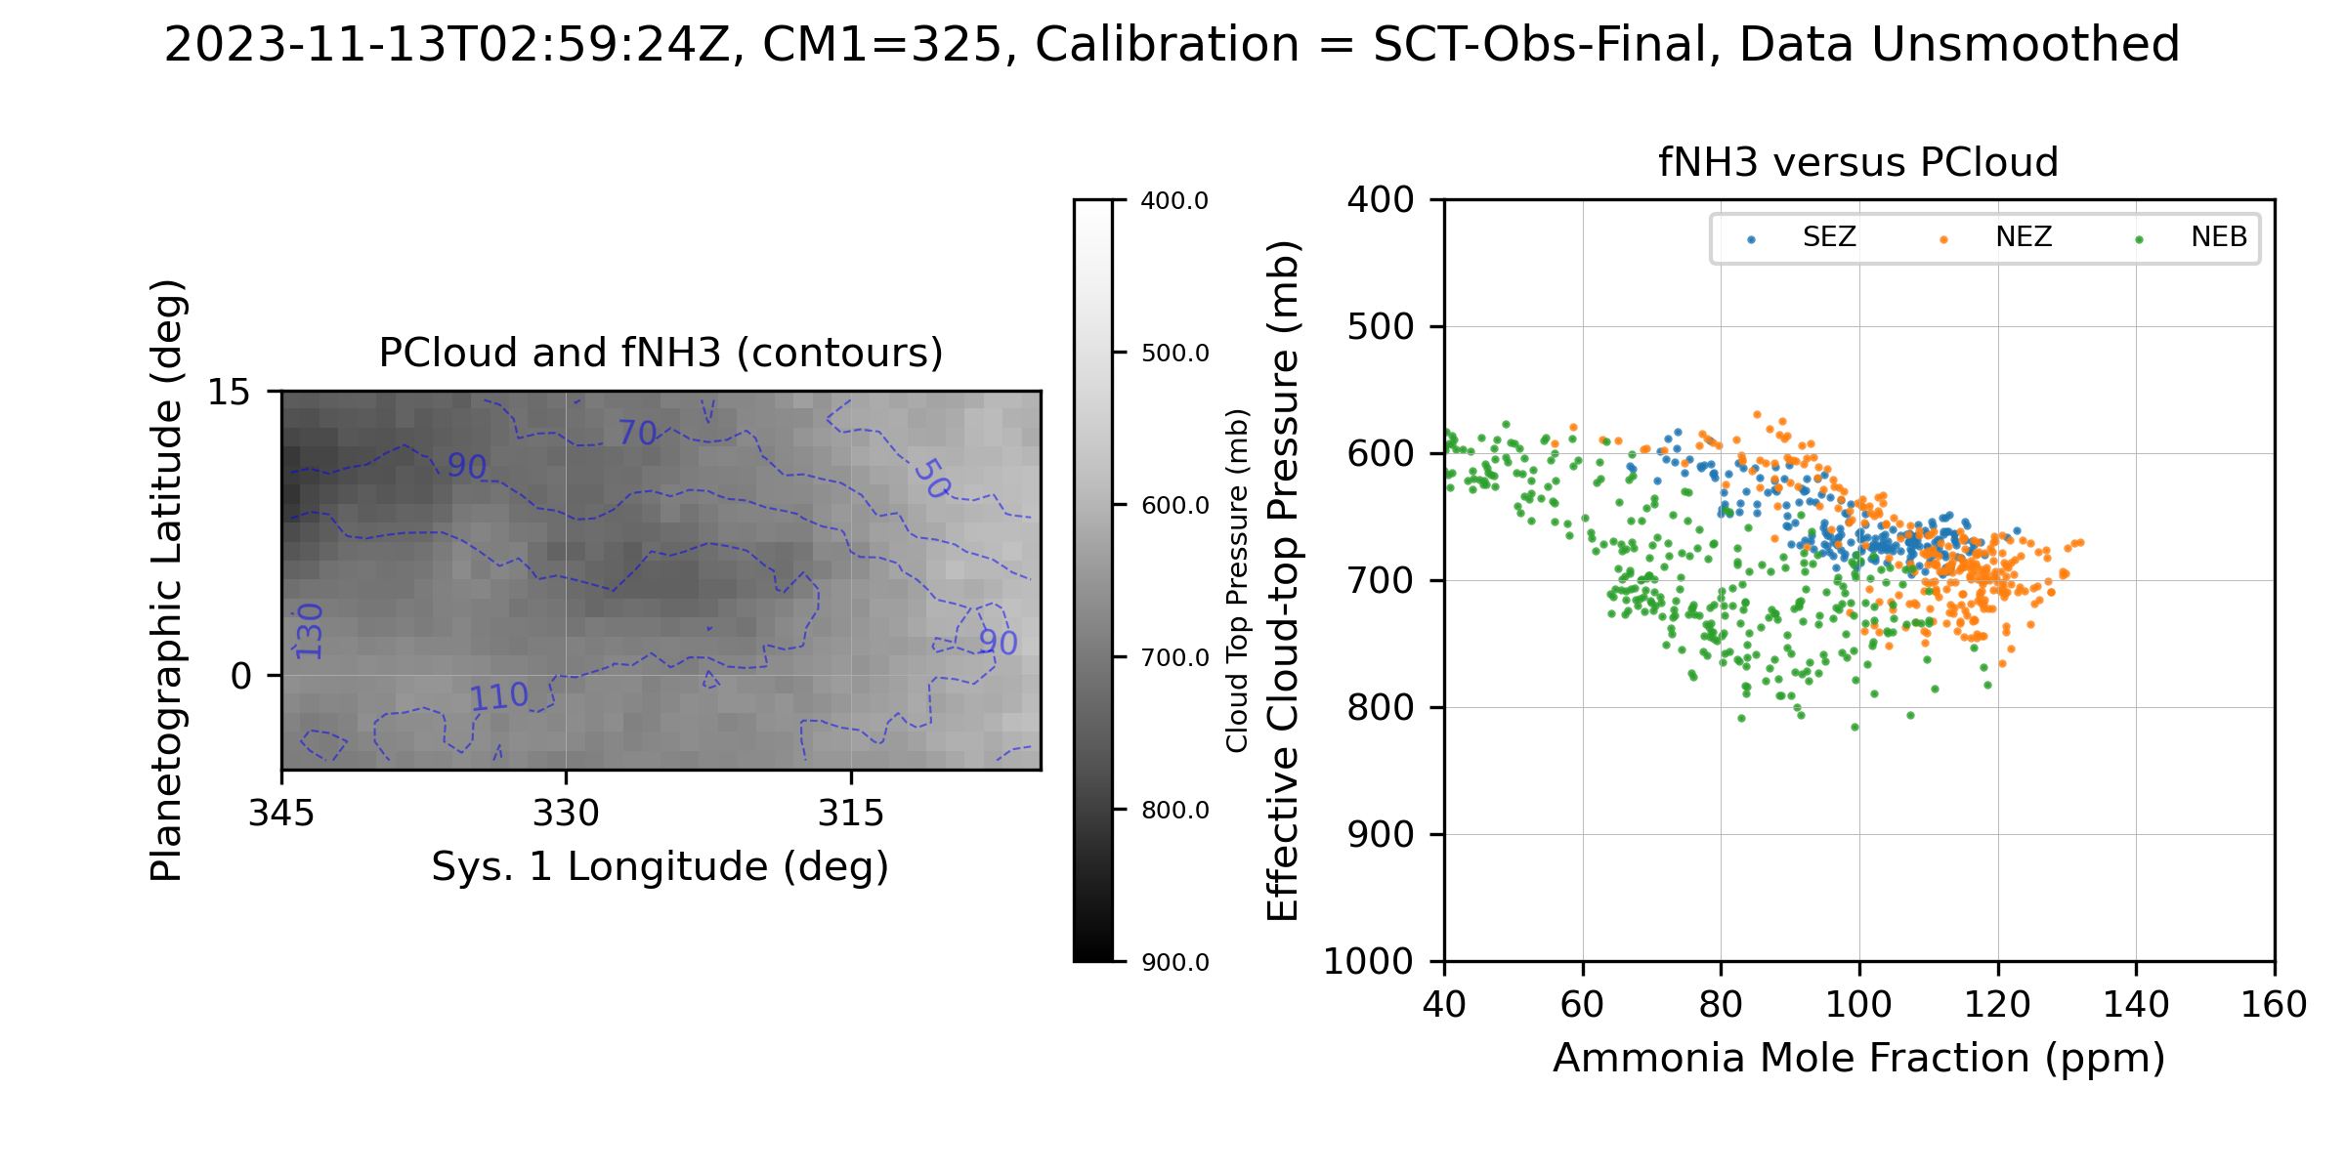
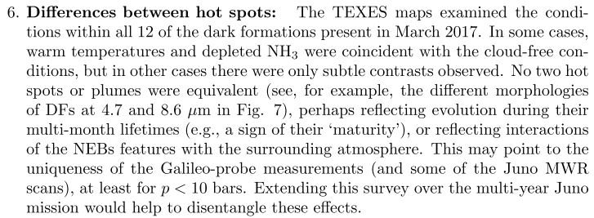
a)
b)
Additional Examples
Spatial resolution is 1-2 arcsec, which translates to about 3-6 deg of latitude.
a-b) show two different regions on different dates
c-d) and e-f) show the same two regions observed 30 mins apart on 2023-11-13. Note that e) was close relatively close to the limb.
Note the variations measured in the MIR showing that ammonia enhancements and depletions are not always directly correlated with hotspots and plumes (Fletcher et al., 2020, excerpts below).
c)
d)
e)
f)

Slide 24
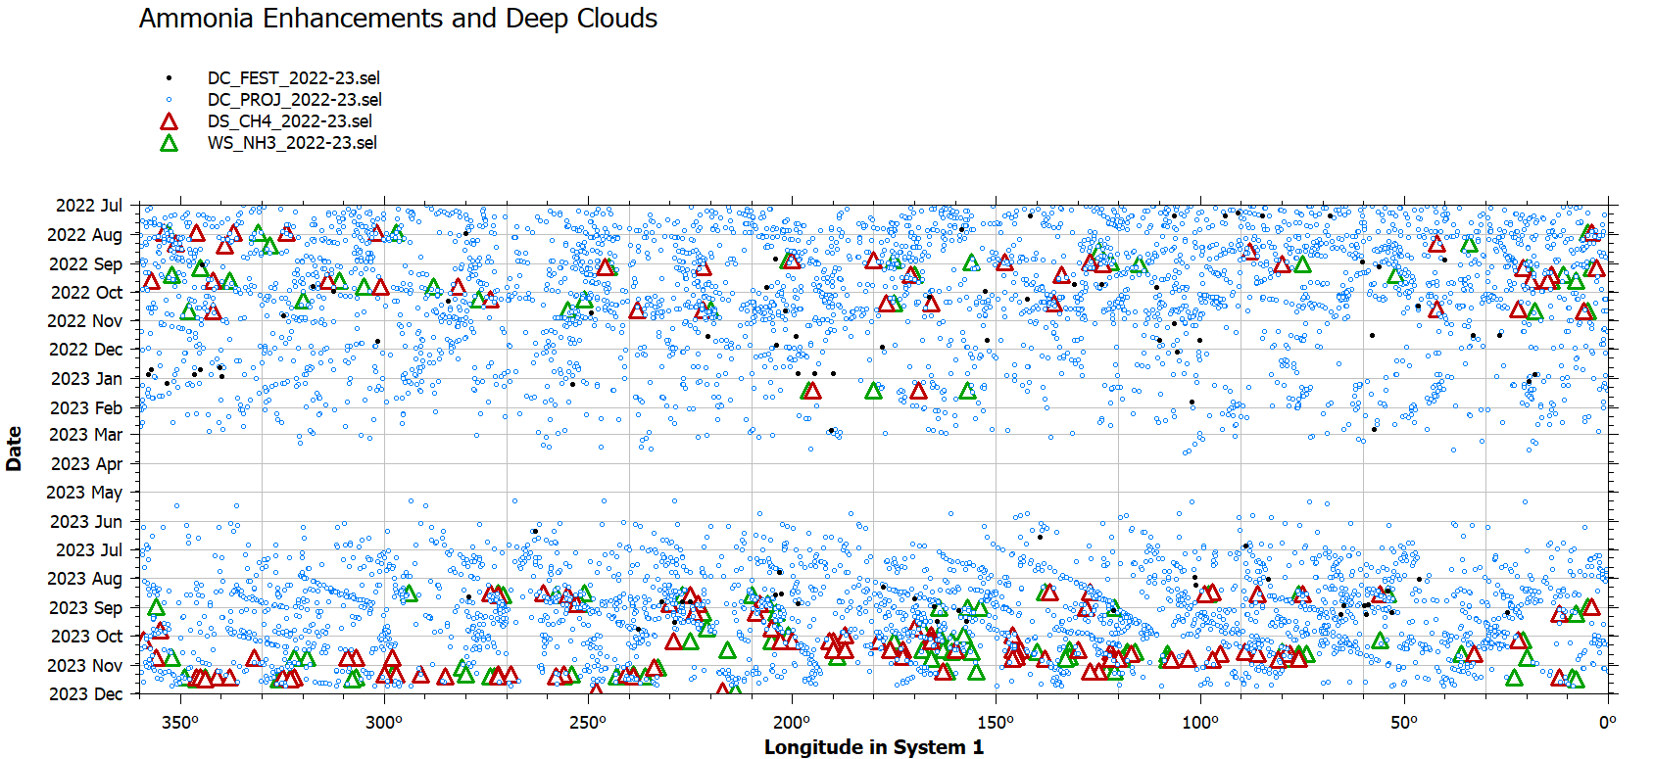
NH₃ and CH₄ Features in Context with WinJUPOS Dark Formations
Centroids of NH₃ enhancements and CH₄ (619nm) deep clouds were measured by visual inspection and entered into WINJupos
Latest release (2023-11-22) of WINJupos measurements of Dark Projections and Festoons

Slide 25
Meteorological Definitions
A convergence zone in meteorology is a region in the atmosphere where two prevailing flows meet and interact, usually resulting in distinctive weather conditions.^{[1]} This causes a mass accumulation that eventually leads to a vertical movement and to the formation of clouds and precipitation.^{[1]}
https://en.wikipedia.org/wiki/Convergence_zone
HOWEVER, If convergence is occurring in the upper troposphere the atmosphere will attempt to compensate by initiating divergence in the lower troposphere, this is called the damper effect. This condition results in downward vertical motion and adiabatic warming, which could represent improving weather with increased stability. This is called the Damper Effect
https://www.weather.gov/source/zhu/ZHU_Training_Page/Miscellaneous/Divergence/divergence.html#:~:text=If%20convergence%20is%20occurring%20in,improving%20weather%20with%20increased%20stability.

